Slide 1





Introduction to Docker
Install Docker
Work with Images and Containers
DevOps
Basics
SoftUni Team
Technical Trainers
Software University
http://softuni.bg

Slide 2

Table of Contents
Containerization
Introduction to Docker
Docker in Action
Create Our Own Images

Slide 3
Have a Question?
sli.do
#SU-DOB-M2

Slide 4
Proposed Environment Setup M2 / M3
VM1
VM2
…
C1
C2
…
C1
C2
…
C1
C2
…
C1
C2
…
Docker
Docker
Docker
CentOS
CentOS
CentOS
Docker
VirtualBox
Host OS
(Win, Linux, Mac)
Host OS
(Win, Linux, Mac)
Module #2
Modules #2 and #3

Slide 5

Quick Recap
DOB Week 1

Slide 6
DOB Week 1
About this Course
The Big Picture
Main Pain Points and Causes
Goals and Benefits
Adoption and Tools
Basic Toolkit
Basic Automation

Slide 7
Containers and Docker
Past. Present. Feature

Slide 8
Road to Containers
Companies and Solutions
2004
Solaris Containers
(zones)
2011
Warden
By CloudFoundry
2000 - 2001
1) FreeBSD Jails
2) Virtuozzo
3) Linux VServer
2005
Virtuozzo OpenVZ
2007
HP-UX Containers
IBM WPAR
2013
Docker
By Docker Inc
2014
Rkt
By CoreOS
1979
chroot
1999
1) Capabilities
2) AppArmor
3) SELinux
2002
Mount Namespaces
2006
1) Process Containers (cgroups) by Google
2) UTS and IPC Namespaces
2008
1) cgroups in kernel
2) PID and Network Namespaces
3) User Namespace
4) LXC
Enablement Technologies

Slide 9
Definitions
Container
Containers are processes with much more isolation
Image
Images provide a way for simpler software distribution
writable layer
Volume
mariadb
Layers
ubuntu
Container

Slide 10
Solutions
LXD by Canonical
Container hypervisor (system containers)
https://www.ubuntu.com/containers/lxd
rkt by CoreOS
Application container engine
https://coreos.com/rkt
Docker by Docker Inc
Application container engine
https://www.docker.com/

Slide 11
Docker
Whole New World

Slide 12
Docker Mission
BUILD.
SHIP.
DEPLOY.

Slide 13
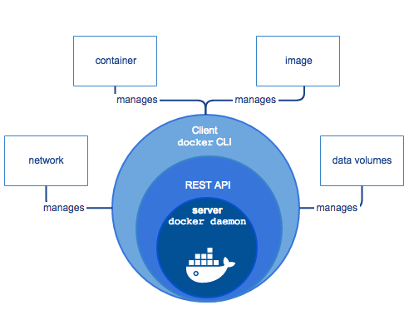
Docker Engine
Client-server application
Components
dockerd daemon
REST API
docker CLI
https://docs.docker.com/engine/docker-overview

Slide 14
Registries
Provided by Docker
Cloud
Docker Hub (https://hub.docker.com/explore/)
Docker Store (https://store.docker.com/)
On-premise
Standalone
Containerized
Provided by 3rd parties
Quay.io, Artifactory, Google Container Registry

Slide 15
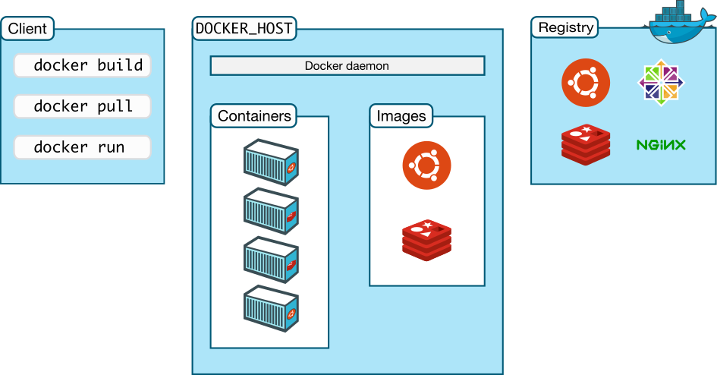
Workflow
1
3
2
https://docs.docker.com/engine/docker-overview

Slide 16
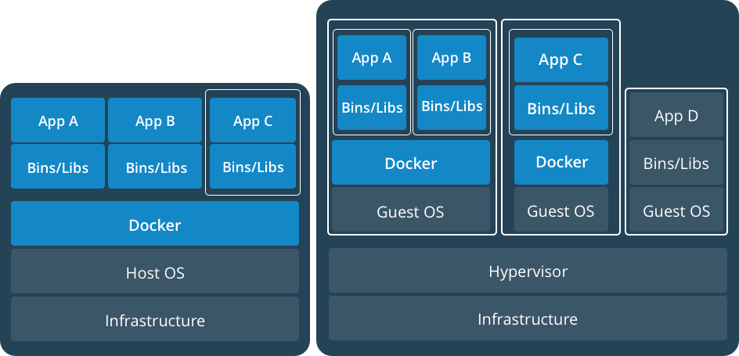
Together: VMs and Containers
https://www.docker.com/what-container

Slide 17
Docker Installation
Options

Slide 18
Installation Options
Two Editions (Community and Enterprise)
Native Options
Docker for Linux
Docker for MAC
Docker for Windows
Docker for Cloud (AWS/Azure)
Docker Toolbox (deprecated) - All-in-one solution
For Mac and Windows

Slide 19
Practice: Installation. Hello World
Live Demonstration in Class

Slide 20
Working with Docker
Commands

Slide 21
Command Specifics
Syntax varies amongst versions
Old style – still available
New Style – preffered
Grouped by target
Management Commands
General Commands

Slide 22
search
Purpose
Search the Docker Hub for images
Old syntax
New syntax
Example
docker search [OPTIONS] TERM
# same
docker search ubuntu

Slide 23
pull
Purpose
Pull an image or a repository from a registry
Old syntax
New syntax
Example
docker pull [OPTIONS] NAME[:TAG|@DIGEST]
docker image pull [OPTIONS] NAME[:TAG|@DIGEST]
docker image pull ubuntu:latest

Slide 24
run
Purpose
Run a command in a new container
Old syntax
New syntax
Example
docker run [OPTIONS] IMAGE [COMMAND] [ARG]
docker container run [OPTIONS] IMAGE [COMMAND] [ARG]
docker container run -it ubuntu

Slide 25
images
Purpose
List images
Old syntax
New syntax
Example
docker images [OPTIONS] [REPOSITORY[:TAG]]
docker image ls [OPTIONS] [REPOSITORY[:TAG]]
docker image ls fedora

Slide 26
ps
Purpose
List containers
Old syntax
New syntax
Example
docker ps [OPTIONS]
docker container ls [OPTIONS]
docker container ls –a -q

Slide 27
rm
Purpose
Remove one or more containers
Old syntax
New syntax
Example
docker rm [OPTIONS] CONTAINER [CONTAINER]
docker container rm [OPTIONS] CONTAINER [CONTAINER]
docker container rm weezy_snake

Slide 28
rmi
Purpose
Remove one or more images
Old syntax
New syntax
Example
docker rmi [OPTIONS] IMAGE [IMAGE]
docker image rm [OPTIONS] IMAGE [IMAGE]
docker image rm ubuntu fedora

Slide 29
create
Purpose
Create a new container
Old syntax
New syntax
Example
docker create [OPTIONS] IMAGE [COMMAND] [ARG]
docker container create [OPTIONS] IMAGE [COMMAND] [ARG]
docker container create -t -i fedora bash

Slide 30
rename
Purpose
Rename a container
Old syntax
New syntax
Example
docker rename CONTAINER NEW_NAME
docker container rename CONTAINER NEW_NAME
docker container rename cont1 newcont1

Slide 31
kill
Purpose
Kill one or more running containers
Old syntax
New syntax
Example
docker kill [OPTIONS] CONTAINER [CONTAINER]
docker container kill [OPTIONS] CONTAINER [CONTAINER]
docker container kill 0cbf27183

Slide 32
start
Purpose
Start one or more stopped containers
Old syntax
New syntax
Example
docker start [OPTIONS] CONTAINER [CONTAINER]
docker container start [OPTIONS] CONTAINER [CONTAINER]
docker container start -a -i 0cbf27183

Slide 33
restart
Purpose
Restart a container
Old syntax
New syntax
Example
docker restart [OPTIONS] CONTAINER [CONTAINER]
docker container restart [OPTIONS] CONTAINER [CONTAINER]
docker container restart 0cbf27183

Slide 34
stop
Purpose
Stop one or more running containers
Old syntax
New syntax
Example
docker stop [OPTIONS] CONTAINER [CONTAINER]
docker container stop [OPTIONS] CONTAINER [CONTAINER]
docker container stop 0cbf27183

Slide 35
pause
Purpose
Pause all processes within one or more containers
Old syntax
New syntax
Example
docker pause CONTAINER [CONTAINER]
docker container pause CONTAINER [CONTAINER]
docker container pause 0cbf27183

Slide 36
unpause
Purpose
Unpause all processes within one or more containers
Old syntax
New syntax
Example
docker unpause CONTAINER [CONTAINER]
docker container unpause CONTAINER [CONTAINER]
docker container unpause 0cbf27183

Slide 37
attach
Purpose
Attach to a running container
Old syntax
New syntax
Example
docker attach [OPTIONS] CONTAINER
docker container attach [OPTIONS] CONTAINER
docker container attach 0cbf27183

Slide 38
tag
Purpose
Tag an image into a repository
Old syntax
New syntax
Example
docker tag SOURCE_IMAGE[:TAG] TARGET_IMAGE[:TAG]
docker image tag SOURCE_IMAGE[:TAG] TARGET_IMAGE[:TAG]
docker image tag test:1.0 repo-name/test:latest

Slide 39
push
Purpose
Push an image or repository to a registry
Old syntax
New syntax
Example
docker push [OPTIONS] NAME[:TAG]
docker image push [OPTIONS] NAME[:TAG]
docker image push repo-name/test:latest

Slide 40
login
Purpose
Log into a Docker registry
Old syntax
New syntax
Example
docker login [OPTIONS] [SERVER]
# same
docker login

Slide 41
logout
Purpose
Log out from a Docker registry
Old syntax
New syntax
Example
docker logout [SERVER]
# same
docker logout

Slide 42
export
Purpose
Export a container’s filesystem as a tar archive
Old syntax
New syntax
Example
docker export [OPTIONS] CONTAINER
docker container export [OPTIONS] CONTAINER
docker container export -o file.tar test

Slide 43
import
Purpose
Import the contents from a tarball to create a filesystem image
Old syntax
New syntax
Example
docker import [OPTIONS] file|URL|- [REPOSITORY[:TAG]]
docker image import [OPTIONS] file|URL|- [REPOSITORY[:TAG]]
docker image import file.tar new-test

Slide 44
save
Purpose
Save one or more images to a tar archive or STDOUT
Old syntax
New syntax
Example
docker save [OPTIONS] IMAGE [IMAGE]
docker image save [OPTIONS] IMAGE [IMAGE]
docker image save -o busybox.tar busybox

Slide 45
load
Purpose
Load an image from a tar archive or STDIN
Old syntax
New syntax
Example
docker load [OPTIONS]
docker image load [OPTIONS]
docker image load -i busybox.tar

Slide 46
Practice: Search. Pull. Push. Load. Save
Live Demonstration in Class

Slide 47
Image from Container

Slide 48
Create with Commit
Commit a container’s file changes to a new image
Use running or stopped container
If running, all processes are paused
Mounted volumes’ data is not included
It is advisable to use Dockerfile instead

Slide 49
commit
Purpose
Create a new image from a container’s changes
Old syntax
New syntax
Example
docker commit [OPTIONS] CONTAINER [REPOSITORY[:TAG]]
docker container commit [OPTIONS] CONTAINER [REPOSITORY[:TAG]]
docker container commit 0cf23a31 new-cont

Slide 50
Image from File
General Structure and Common Fields

Slide 51
General Structure (Dockerfile)
Script, composed of commands and arguments
Always begins with FROM instruction
Comment
# Set the base image
FROM nginx
# Set the maintainer
MAINTAINER John Smith
# Copy files
COPY index.html /usr/share/nginx/html/
Command
(Instruction)

Slide 52
FROM
Purpose
Defines the base image to use to start the build process
Syntax
Example
FROM [image name]
FROM ubuntu

Slide 53
MAINTAINER
Purpose
Sets the author field of the image. It is deprecated
Syntax
Example
MAINTAINER [name]
MAINTAINER John Smith
LABEL maintainer "John Smith"

Slide 54
RUN
Purpose
Used during build process to add software (forms another layer)
Syntax
Example
RUN [command]
RUN apt-get -y update

Slide 55
COPY
Purpose
Copy files between the host and the container
Syntax
Example
COPY [source or URL] [destination]
COPY /my_app_folder /my_app_folder

Slide 56
EXPOSE
Purpose
Informs Docker that the container listens on the specified ports
Syntax
Example
EXPOSE <port> [<port>...]
EXPOSE 80

Slide 57
ENTRYPOINT
Purpose
Allows you to configure a container that will run as an executable
Syntax
# exec form, this is the preferred form
ENTRYPOINT ["executable", "param1", "param2"]
# shell form
ENTRYPOINT command param1 param2

Slide 58
CMD
Purpose
Main purpose is to provide defaults for an executing container
Syntax
# exec form, this is the preferred form
CMD ["executable","param1","param2"]
# as default parameters to ENTRYPOINT
CMD ["param1","param2"]
# shell form
CMD command param1 param2

Slide 59
CMD and ENTRYPOINT
Both define what command gets executed when running a container
Dockerfile should specify at least one of them
ENTRYPOINT should be defined when using the container as an executable
CMD should be used as a way of defining default arguments for an ENTRYPOINT command or for executing an ad-hoc command in a container
CMD will be overridden when running the container with alternative arguments

Slide 60
CMD and ENTRYPOINT
Both have exec and shell form
When used together always use their exec form
 |  | ENTRYPOINT
 |  | N/A | exec_entry p1_entry | [“exec_entry”, “p1_entry”]
CMD | N/A | Error | /bin/sh -c exec_entry p1_entry | exec_entry p1_entry
 | [“exec_cmd”, “p1_cmd”] | exec_cmd p1_cmd | /bin/sh -c exec_entry p1_entry | exec_entry p1_entry exec_cmd p1_cmd
 | [“p1_cmd”, “p2_cmd”] | p1_cmd p2_cmd | /bin/sh -c exec_entry p1_entry | exec_entry p1_entry p1_cmd p2_cmd
 | exec_cmd p1_cmd | /bin/sh -c exec_cmd p1_cmd | /bin/sh -c exec_entry p1_entry | exec_entry p1_entry /bin/sh -c exec_cmd p1_cmd
https://docs.docker.com/engine/reference/builder/#understand-how-cmd-and-entrypoint-interact

Slide 61
build
Purpose
Build an image from a Dockerfile
Old syntax
New syntax
Example
docker build [OPTIONS] PATH | URL | -
docker image build [OPTIONS] PATH | URL | -
docker image build -t new-image .

Slide 62
Recommendations

Slide 63
Recommendations
Don’t create large images
Don’t use only the “latest” tag
Don’t run more than one process in a single container
Don’t rely on IP addresses
Put information about the author
https://developers.redhat.com/blog/2016/02/24/10-things-to-avoid-in-docker-containers/
http://www.projectatomic.io/docs/docker-image-author-guidance/

Slide 64
Heredoc Container
Why not?!

Slide 65
Heredoc Container
Purpose
Create a new image on the fly ☺
Example
docker build -t htop - << EOF
FROM alpine
RUN apk --no-cache add htop
EOF

Slide 66
Practice: Create Few Containers
Live Demonstration in Class

Slide 67
Resources
Docker Documentation
https://docs.docker.com/
Docker Hub Documentation
https://docs.docker.com/docker-hub/
Docker Registry Documentation
https://docs.docker.com/registry/

Slide 68
Summary
Containerization is a hot topic, but it isn’t something new
Docker is de-facto a standard
Docker is offered in two versions – CE and EE
There are several installation options
Images can be published to private or public registries
Two sets of commands are still available
There are multiple ways to create an image

Slide 69







Introduction to Docker
https://softuni.bg/courses/

Slide 70





Trainings @ Software University (SoftUni)
Software University – High-Quality Education, Profession and Job for Software Developers
softuni.bg
Software University Foundation
http://softuni.foundation/
Software University @ Facebook
facebook.com/SoftwareUniversity
Software University Forums
forum.softuni.bg

